Slide 1
Support Vector Machines

Slide 2
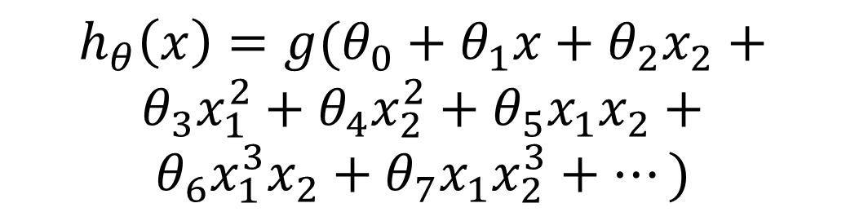

Regularized logistic regression
Cost function:
$$J\left(θ\right)=\frac{1}{m}\left[\sum_{i=1}^{m}{y^{\left(i\right)}\log{h_{θ}\left(x^{\left(i\right)}\right)}+(1−y^{\left(i\right)})\log\left(1−h_{θ}\left(x^{\left(i\right)}\right)\right)}+\frac{λ}{2}\sum_{j=1}^{n}{θ_{j}^{2}}\right]$$
$$h_{θ}\left(x\right)={g(θ}_{0}+θ_{1}x+θ_{2}x_{2}+$$
$$θ_{3}x_{1}^{2}+θ_{4}x_{2}^{2}+θ_{5}x_{1}x_{2}+$$
$$θ_{6}x_{1}^{3}x_{2}+θ_{7}x_{1}x_{2}^{3}+⋯)$$
Age
Tumor Size

Slide 3
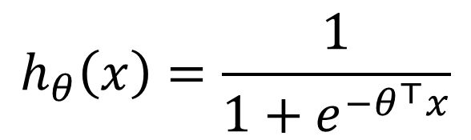
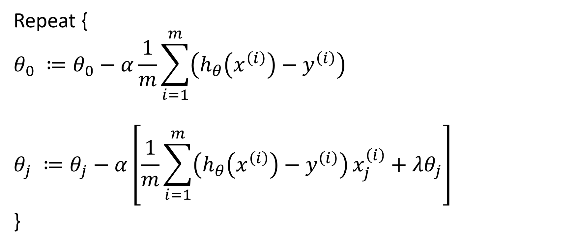

Gradient descent (Regularized)
Repeat {
$$θ_{0} ≔θ_{0}−α\frac{1}{m}\sum_{i=1}^{m}{\left(h_{θ}\left(x^{\left(i\right)}\right)−y^{\left(i\right)}\right)}$$
$$θ_{j} ≔θ_{j}−α\left[\frac{1}{m}\sum_{i=1}^{m}{\left(h_{θ}\left(x^{\left(i\right)}\right)−y^{\left(i\right)}\right)}x_{j}^{\left(i\right)}+λθ_{j}\right]$$
}
$$h_{θ}\left(x\right)=\frac{1}{1+e^{−θ^{⊤}x}}$$
$$\frac{∂}{∂θ_{j}}J(θ)$$

Slide 4
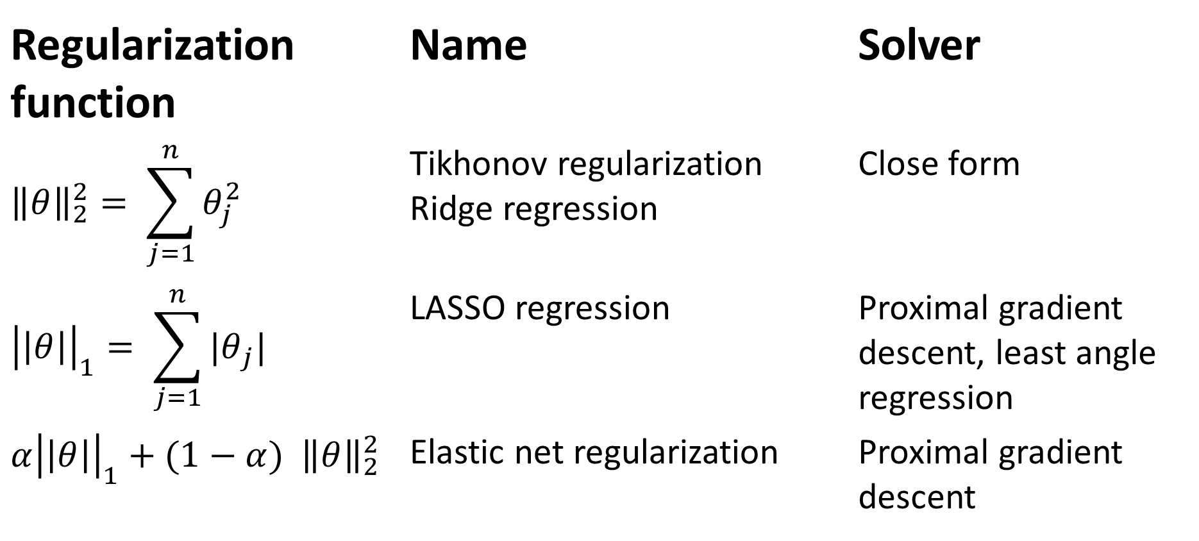
Terminology
Regularization function | Name | Solver
$${\left\|θ\right\|}_{2}^{2}= \sum_{j=1}^{n}{θ_{j}^{2}}$$ | Tikhonov regularization Ridge regression | Close form
$${\left|\left|θ\right|\right|}_{1}= \sum_{j=1}^{n}{{|θ}_{j}| }$$ | LASSO regression | Proximal gradient descent, least angle regression
$$α{\left|\left|θ\right|\right|}_{1}+(1−α){ \left\|θ\right\|}_{2}^{2}$$ | Elastic net regularization | Proximal gradient descent

Slide 5
Support Vector Machine
Cost function
Large margin classification
Kernels
Using an SVM

Slide 6
Support Vector Machine
Cost function
Large margin classification
Kernels
Using an SVM

Slide 7
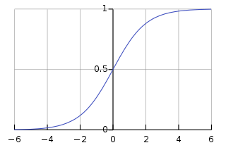
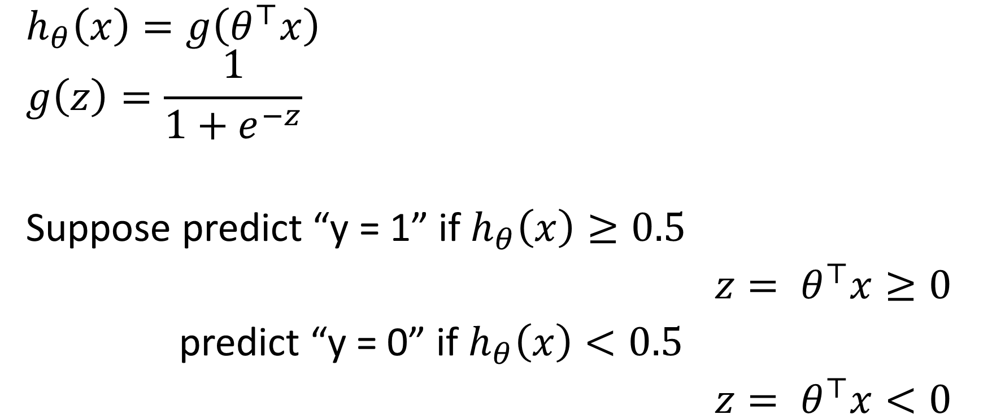


Logistic regression
$$g(z)$$
$$h_{θ}\left(x\right)=g\left(θ^{⊤}x\right)$$
$$g\left(z\right)=\frac{1}{1+e^{−z}}$$
Suppose predict “y = 1” if $h_{θ}\left(x\right)≥0.5$
$${z= θ}^{⊤}x≥0$$
predict “y = 0” if $h_{θ}\left(x\right)<0.5$
$${z= θ}^{⊤}x<0$$
$$z=θ^{⊤}x$$

Slide 8
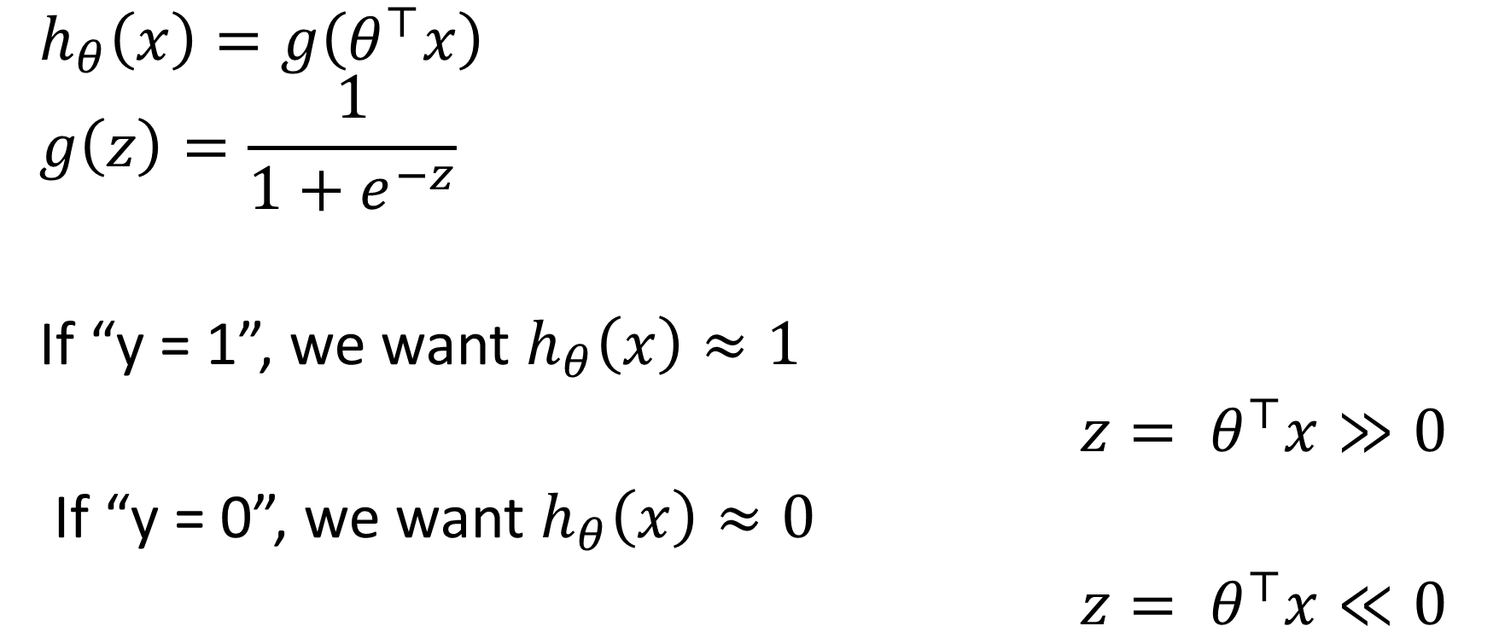
Alternative view
$$g(z)$$
$$h_{θ}\left(x\right)=g\left(θ^{⊤}x\right)$$
$$g\left(z\right)=\frac{1}{1+e^{−z}}$$
If “y = 1”, we want $h_{θ}\left(x\right)≈1$
$${z= θ}^{⊤}x≫0$$
If “y = 0”, we want $h_{θ}\left(x\right)≈0$
$${z= θ}^{⊤}x≪0$$
$$z=θ^{⊤}x$$

Slide 9



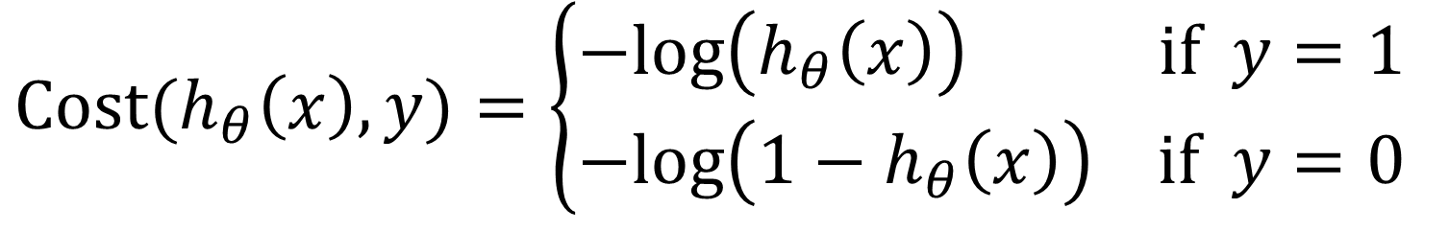





Cost function for Logistic Regression
$$Cost(h_{θ}\left(x\right),y)=\left\{\begin{aligned}−log\left(h_{θ}\left(x\right)\right) if y=1 \\ −log\left({1−h}_{θ}\left(x\right)\right) if y=0\end{aligned}\right.$$
$$if y=1$$
$$if y=0$$
$$0$$
$$h_{θ}\left(x\right)$$
$$1$$
$$0$$
$$h_{θ}\left(x\right)$$
$$1$$

Slide 10
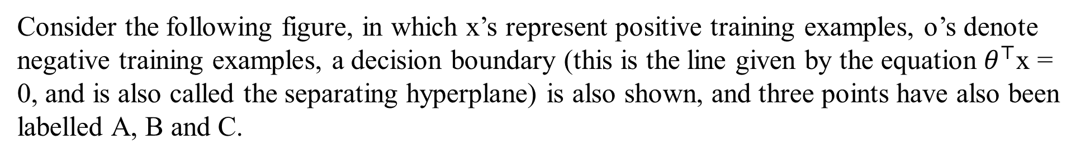
Margins: Intuition
Consider the following figure, in which x’s represent positive training examples, o’s denote negative training examples, a decision boundary (this is the line given by the equation $θ^{⊤}$x = 0, and is also called the separating hyperplane) is also shown, and three points have also been labelled A, B and C.

Slide 11
Notice that the point A is very far from the decision boundary. If we are
asked to make a prediction for the value of y at A, it seems we should be
quite confident that y = 1 there.
Conversely, the point C is very close to the decision boundary, and while it’s on the side of the decision boundary on which we would predict y = 1, it seems likely that just a small change to the decision boundary could easily have caused out prediction to be y = 0.
Hence, we’re much more confident about our prediction at A than at C.
The point B lies in-between these two cases, and more broadly, we see that if a point is far from the separating hyperplane, then we may be significantly more confident in our predictions.

Slide 12
Notation
For SVM we will be considering a linear classifier for a binary classification problem with labels y and features x.
We’ll use y ∈ {−1, 1} (instead of {0, 1}) to denote the class labels.
Also, rather than parameterizing our linear classifier with the vector θ, we will use parameters w, b, and write our classifier as
h_{w,b}(x) = g(w^{T} x + b).
Here, g(z) = 1 if z ≥ 0,
and g(z) = −1 otherwise.
This “w, b” notation allows us to explicitly treat the intercept term b separately from the other
parameters. (We also drop the convention we had previously of letting x₀ = 1 be an extra coordinate in the input feature vector.)
Thus, b takes the role of what was previously θ₀, and w takes the role of [θ₁ . . . θ_{n}]^{T}
From our definition of g above, our classifier will directly predict either 1 or -1.

Slide 13






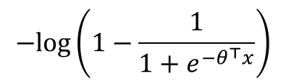










Alternative view of logistic regression
$Cost\left(h_{θ}\left(x\right),y\right)=− y log\left(h_{θ}\left(x\right)\right)−(1−y)log\left({1−h}_{θ}\left(x\right)\right)$ $= y \left(−log\left(\frac{1}{1+e^{−θ^{⊤}x}}\right)\right)+\left(1−y\right) \left(−log\left(1−\frac{1}{1+e^{−θ^{⊤}x}}\right)\right)$
0
$$−log\left(\frac{1}{1+e^{−θ^{⊤}x}}\right)$$
$$−log\left(1−\frac{1}{1+e^{−θ^{⊤}x}}\right)$$
$$if y=1$$
$$if y=0$$
$$−2$$
$$−1$$
$$0$$
$$1$$
$$2$$
$$θ^{⊤}x$$
$$−2$$
$$−1$$
$$0$$
$$1$$
$$2$$
$$θ^{⊤}x$$

Slide 14

Logistic regression (logistic loss)
$$\min_{θ} \frac{1}{m}\left[\sum_{i=1}^{m}{y^{(i)}\left(−log\left(h_{θ}\left(x^{(i)}\right)\right)\right)+(1−y^{\left(i\right)}\text{)}\left(−log\left({1−h}_{θ}\left(x^{(i)}\right)\right)\right) }\right]+\frac{λ}{2m }\sum_{j=1}^{n}{θ_{j}^{2}}$$
Support vector machine (hinge loss)
$$\min_{θ} \frac{1}{m}\left[\sum_{i=1}^{m}{y^{(i)} cost_{1}\left(θ^{⊤}x^{\left(i\right)}\right)+(1−y^{\left(i\right)}\text{)} cost_{0}\left(θ^{⊤}x^{\left(i\right)}\right)}\right]+\frac{λ}{2m }\sum_{j=1}^{n}{θ_{j}^{2}}$$
0
$$−log\left(\frac{1}{1+e^{−θ^{⊤}x}}\right)$$
$$−log\left(1−\frac{1}{1+e^{−θ^{⊤}x}}\right)$$
$$if y=1$$
$$if y=0$$
$$−2$$
$$−1$$
$$0$$
$$1$$
$$2$$
$$θ^{⊤}x$$
$$−2$$
$$−1$$
$$0$$
$$1$$
$$2$$
$$θ^{⊤}x$$

Slide 15
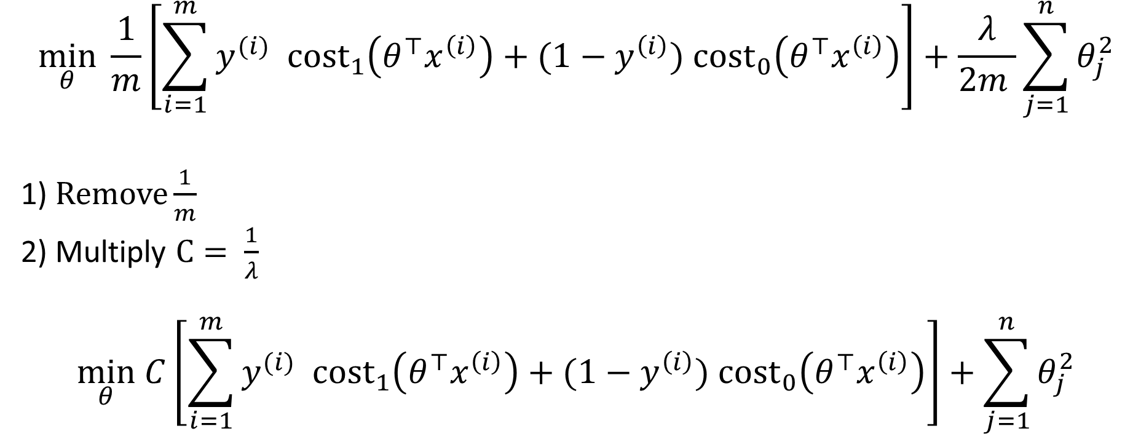
Optimization objective for SVM
$$\min_{θ} \frac{1}{m}\left[\sum_{i=1}^{m}{y^{(i)} cost_{1}\left(θ^{⊤}x^{\left(i\right)}\right)+(1−y^{\left(i\right)}\text{)} cost_{0}\left(θ^{⊤}x^{\left(i\right)}\right)}\right]+\frac{λ}{2m }\sum_{j=1}^{n}{θ_{j}^{2}}$$
1) $Remove\frac{1}{m}$
2) Multiply $C= \frac{1}{λ}$
$$\min_{θ} C\left[\sum_{i=1}^{m}{y^{(i)} cost_{1}\left(θ^{⊤}x^{\left(i\right)}\right)+(1−y^{\left(i\right)}\text{)} cost_{0}\left(θ^{⊤}x^{\left(i\right)}\right)}\right]+\sum_{j=1}^{n}{θ_{j}^{2}}$$

Slide 16
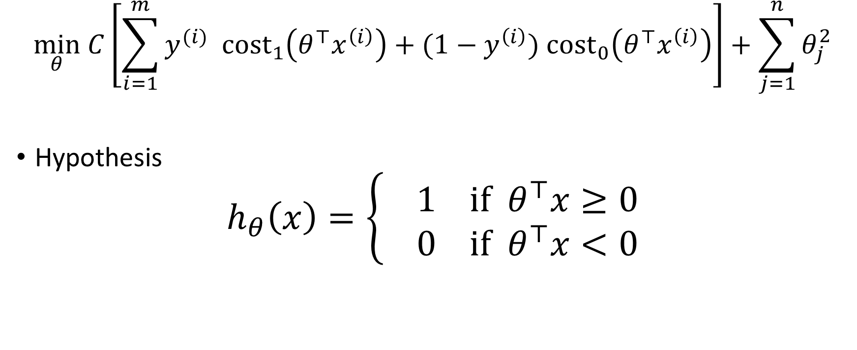
Hypothesis of SVM
$$\min_{θ} C\left[\sum_{i=1}^{m}{y^{(i)} cost_{1}\left(θ^{⊤}x^{\left(i\right)}\right)+(1−y^{\left(i\right)}\text{)} cost_{0}\left(θ^{⊤}x^{\left(i\right)}\right)}\right]+\sum_{j=1}^{n}{θ_{j}^{2}}$$
Hypothesis
$$h_{θ}\left(x\right)=\left\{ \begin{aligned}1 if θ^{⊤}x≥0 \\ 0 if{ θ}^{⊤}x<0\end{aligned}\right.$$

Slide 17
Support Vector Machine
Cost function
Large margin classification
Kernels
Using an SVM

Slide 18

















Support vector machine
$$\min_{θ} C\left[\sum_{i=1}^{m}{y^{(i)} cost_{1}\left(θ^{⊤}x^{\left(i\right)}\right)+(1−y^{\left(i\right)}\text{)} cost_{0}\left(θ^{⊤}x^{\left(i\right)}\right)}\right]+\sum_{j=1}^{n}{θ_{j}^{2}}$$
If “y = 1”, we want $θ^{⊤}x≥ 1$($not just ≥0)$
If “y = 0”, we want${ θ}^{⊤}x≤−1$($not just <0)$
$$cost_{1}\left(θ^{⊤}x\right)$$
$$cost_{0}\left(θ^{⊤}x\right)$$
$$if y=1$$
$$if y=0$$
$$−2$$
$$−1$$
$$0$$
$$1$$
$$2$$
$$θ^{⊤}x$$
$$−2$$
$$−1$$
$$0$$
$$1$$
$$2$$
$$θ^{⊤}x$$

Slide 19

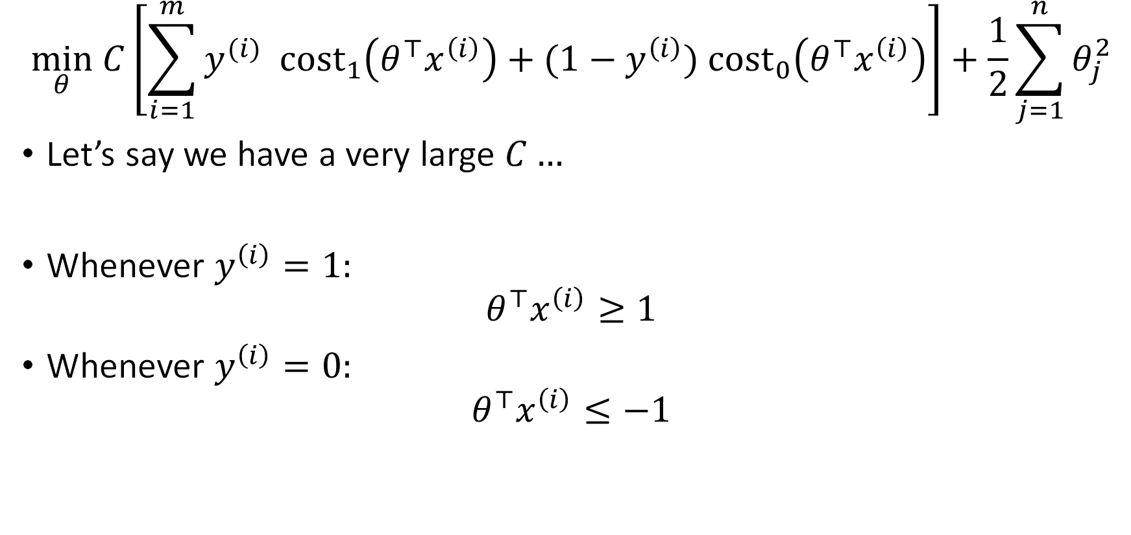
SVM decision boundary
$$\min_{θ} C\left[\sum_{i=1}^{m}{y^{(i)} cost_{1}\left(θ^{⊤}x^{\left(i\right)}\right)+(1−y^{\left(i\right)}\text{)} cost_{0}\left(θ^{⊤}x^{\left(i\right)}\right)}\right]+\frac{1}{2}\sum_{j=1}^{n}{θ_{j}^{2}}$$
Let’s say we have a very large $C…$
Whenever $y^{\left(i\right)}=1:$
$$θ^{⊤}x^{\left(i\right)}≥1$$
Whenever $y^{\left(i\right)}=0:$
$$θ^{⊤}x^{\left(i\right)}≤−1$$
$$\min_{θ}\frac{1}{2}\sum_{j=1}^{n}{θ_{j}^{2}} \\ s.t.{ θ}^{⊤}x^{\left(i\right)}≥1 if y^{\left(i\right)}=1$$
$${ θ}^{⊤}x^{\left(i\right)}≤−1 if y^{\left(i\right)}=0$$

Slide 20

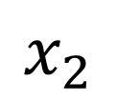
SVM decision boundary: Linearly separable case
$$x_{2}$$
$$x_{1}$$

Slide 21
SVM decision boundary: Linearly separable case
$$x_{2}$$
margin
$$x_{1}$$

Slide 22
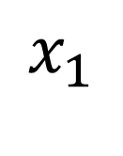
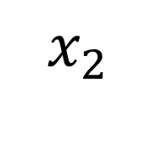


Large margin classifier in the presence of outlier
$C$ very large
$$x_{2}$$
$C$ not too large
$$x_{1}$$

Slide 23



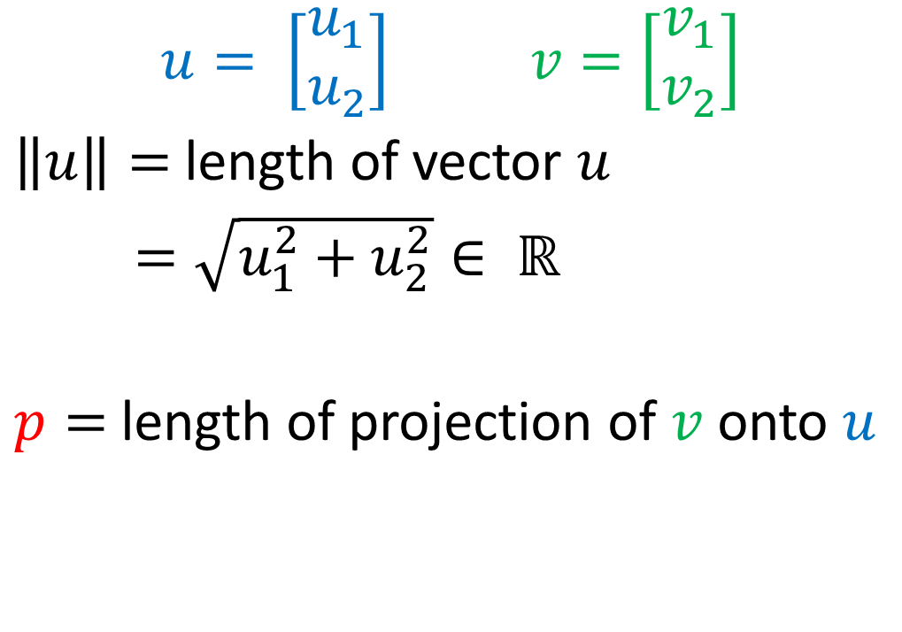




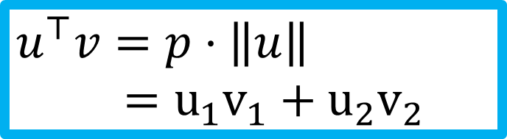
Vector inner product
$$u= \left[\begin{aligned}u_{1} \\ u_{2}\end{aligned}\right] v=\left[\begin{aligned}v_{1} \\ v_{2}\end{aligned}\right]$$
$\left\|u\right\|=$length of vector $u$
$$=\sqrt{u_{1}^{2}+u_{2}^{2}}∈ ℝ$$
$p=$length of projection of $v$ onto $u$
$$v$$
$$v_{2}$$
$$u$$
$$u_{2}$$
$$p$$
$$v_{1}$$
$$u_{1}$$
$$u^{⊤}v=p⋅\left\|u\right\| \\ =u_{1}v_{1}+u_{2}v_{2}$$

Slide 24

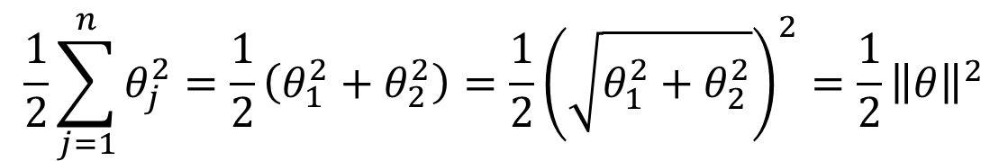

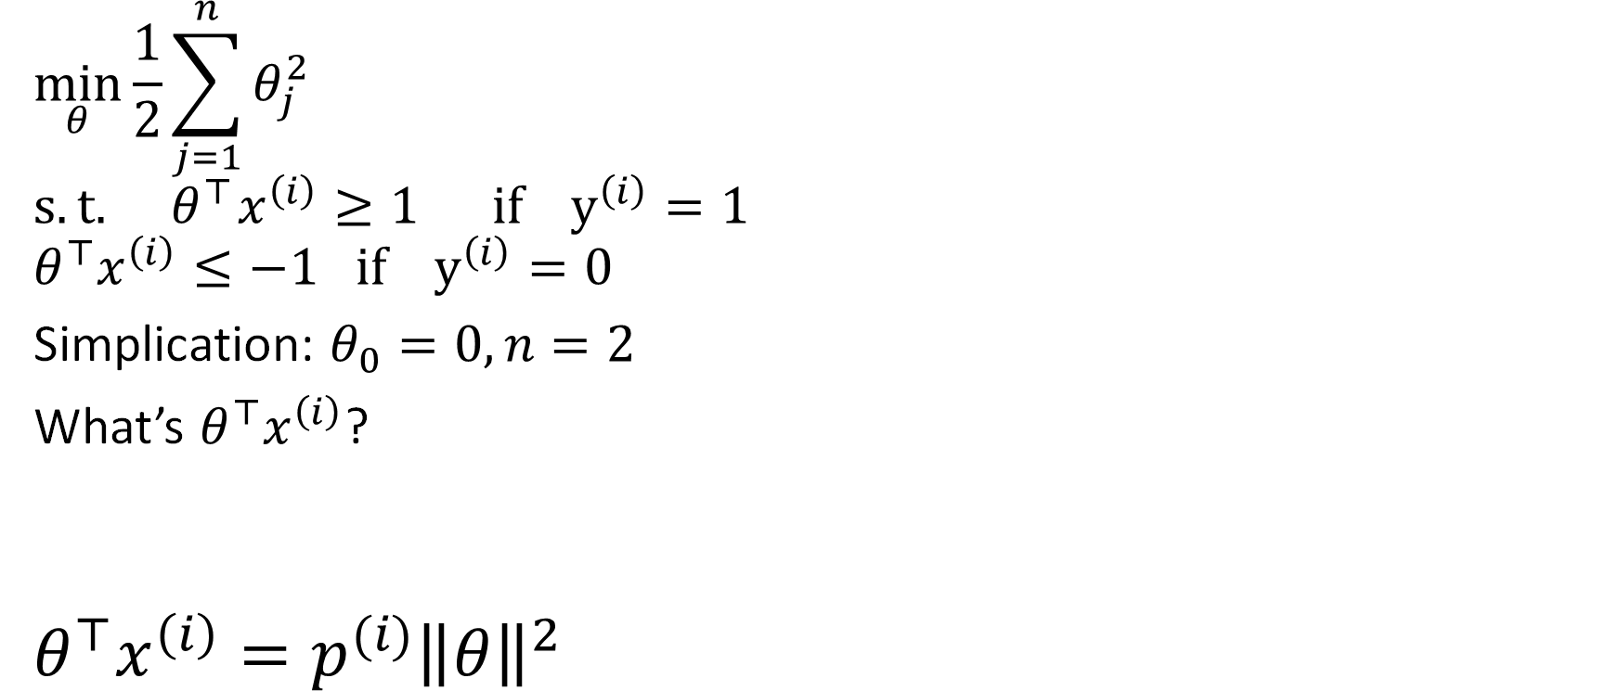





SVM decision boundary
$$\frac{1}{2}\sum_{j=1}^{n}{θ_{j}^{2}}=\frac{1}{2}\left(θ_{1}^{2}+θ_{2}^{2}\right)=\frac{1}{2}{\left(\sqrt{θ_{1}^{2}+θ_{2}^{2}}\right)}^{2}=\frac{1}{2}{\left\|θ\right\|}^{2}$$
$$\min_{θ}\frac{1}{2}\sum_{j=1}^{n}{θ_{j}^{2}} \\ s.t.{ θ}^{⊤}x^{\left(i\right)}≥1 if y^{\left(i\right)}=1 \\ θ^{⊤}x^{\left(i\right)}≤−1 if y^{\left(i\right)}=0$$
Simplication: $θ_{0}=0, n=2$
What’s $θ^{⊤}x^{\left(i\right)}$?
$$θ^{⊤}x^{\left(i\right)}=p^{(i)}{\left\|θ\right\|}^{2}$$
$$x^{(i)}$$
$$x_{2}^{\left(i\right)}$$
$$θ$$
$${\text{θ}}_{2}$$
$$p^{(i)}$$
$$x_{1}^{\left(i\right)}$$
$$θ_{1}$$

Slide 25








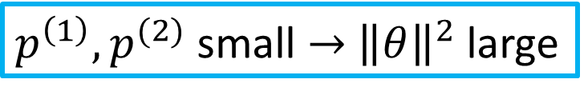
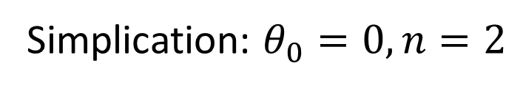
SVM decision boundary
$$\min_{θ}\frac{1}{2}{\left\|θ\right\|}^{2} \\ s.t.{ p}^{(i)}{\left\|θ\right\|}^{2}≥1 if y^{\left(i\right)}=1 \\ { p}^{(i)}{\left\|θ\right\|}^{2}≤−1 if y^{\left(i\right)}=0$$
Simplication: $θ_{0}=0, n=2$
$p^{\left(1\right)},p^{(2)}$ small $→{\left\|θ\right\|}^{2}$ large
$p^{\left(1\right)},p^{(2)}$ large $→{\left\|θ\right\|}^{2}$ can be small
$$θ$$
$$x^{\left(2\right)}$$
$$x^{\left(2\right)}$$
$$θ$$
$$x^{\left(1\right)}$$
$$x^{\left(1\right)}$$

Slide 26
Support Vector Machine
Cost function
Large margin classification
Kernels
Using an SVM

Slide 27
SVM: Introducing Nonlinearity
x₂
Need to generate new features!

Slide 28
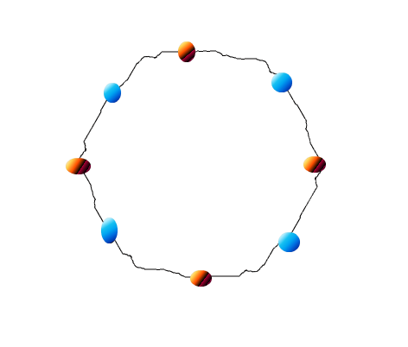
Kernel trick ?
There is no straight line (hyper plane in 2 dimensions) which can separate red and blue dots.
Generate more features!
Inseparable data! T________T
What to do? ☹

Slide 29
Nonlinear SVM classification
Although linear SVM classifiers are efficient and work surprisingly well in many cases, many datasets are not even close to being linearly separable. One approach to handling nonlinear datasets is to add more features, such as polynomial features, in some cases this can result in a linearly separable dataset.
Consider the left plot in figure: it represents a simple dataset with just one feature x1.
This dataset is not linearly separable, as you can see. But if you add a second feature x2 = (x1)², the
resulting 2D dataset is perfectly linearly separable.
Click toadd text

Slide 30
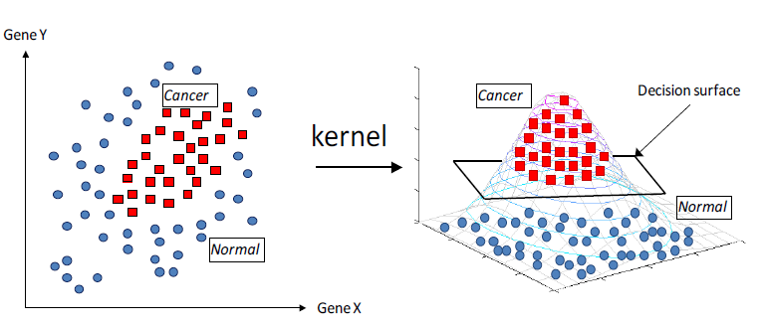
Example of kernel trick

Slide 31
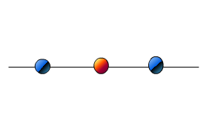
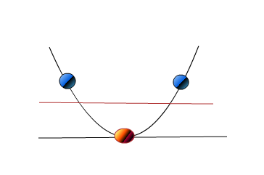
Kernel trick? Simple as it is
Inseparable data
project all points up to a two dimensional space using the mapping
We can indeed find a hyper plane to separate data with SVM.
The mapping in this case is called KERNEL FUNCTION

Slide 32



Non-linear decision boundary
$$x_{2}$$
Predict $y=1 if$
$$θ_{0}+θ_{1}x_{1}+θ_{2}x_{2}+θ_{3}x_{1}x_{2}$$
$$+ θ_{4}x_{1}^{2}+θ_{5}x_{2}^{2}+⋯≥0$$
$$θ_{0}+θ_{1}f_{1}+θ_{2}f_{2}+θ_{3}f_{3}+⋯$$
$$f_{1}=x_{1}, f_{2}=x_{2}, f_{3}=x_{1}x_{2}, ⋯$$
Is there a different/better choice of the features $f_{1},f_{2},f_{3}, ⋯$?
$$x_{1}$$

Slide 33
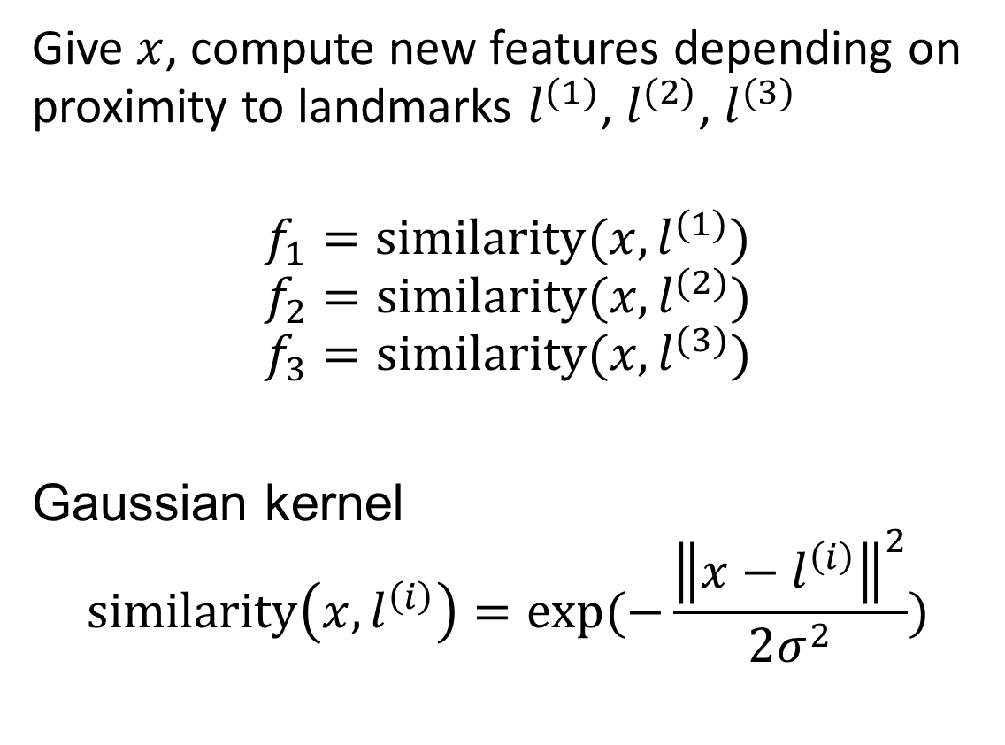
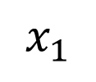



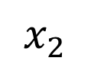
Kernel
$$x_{2}$$
$$l^{(1)}$$
$$l^{(2)}$$
$$l^{(3)}$$
$$x_{1}$$

Slide 34
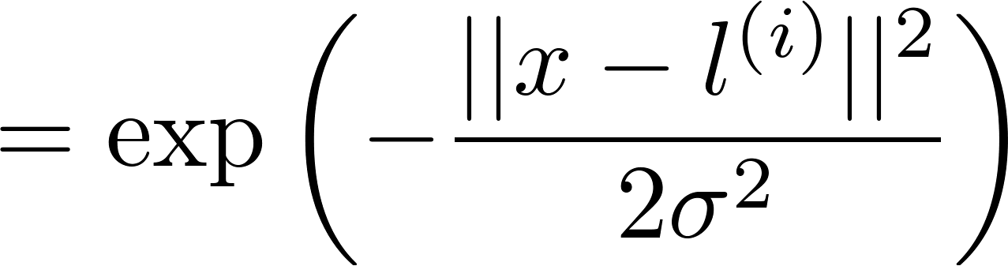
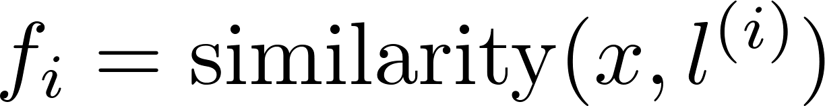
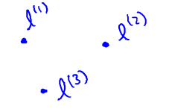


Kernel trick in practice
x₂
f is approx 1
f is approx 0

Slide 35
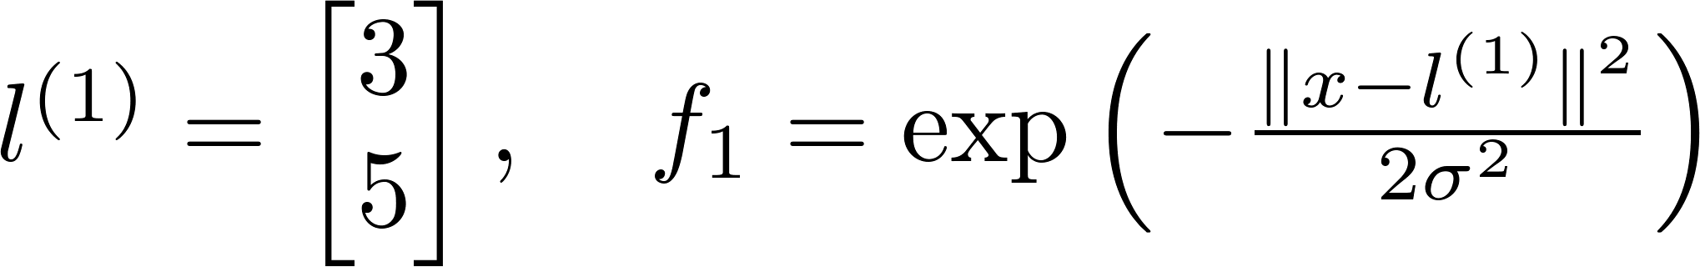
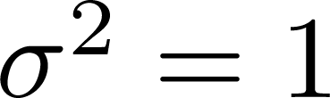
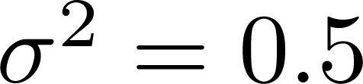







SVM with radial basis kernels: sigma

Slide 36







$$x_{2}$$
$$l^{(1)}$$
$$l^{(2)}$$
Predict $y=1 if$
$$θ_{0}+θ_{1}f_{1}+θ_{2}f_{2}+θ_{3}f_{3}≥0$$
Ex: $θ_{0}=−0.5, θ_{1}=1, θ_{2}=1, θ_{3}=0$
$$l^{(3)}$$
$$x_{1}$$
$$f_{1}=similarity(x, l^{(1)})$$
$$f_{2}=similarity(x, l^{(2)})$$
$$f_{3}=similarity(x, l^{(3)})$$

Slide 37




Choosing the landmarks
Given $x$
$$f_{i}=similarity\left(x,l^{\left(i\right)}\right)=exp⁡(−\frac{{\left\|x−l^{\left(i\right)}\right\|}^{2}}{2σ^{2}})$$
Predict $y=1 if θ_{0}+θ_{1}f_{1}+θ_{2}f_{2}+θ_{3}f_{3}≥0$
Where to get $l^{(1)},l^{(2)},l^{\left(3\right)}, ⋯?$
$$l^{\left(1\right)}$$
$$l^{\left(2\right)}$$
$$l^{\left(3\right)}$$
$$⋮$$
$$l^{\left(m\right)}$$
$$x_{2}$$
$$x_{1}$$

Slide 38


SVM with kernels
Given $\left(x^{\left(1\right)},y^{\left(1\right)}\right), \left(x^{\left(2\right)},y^{\left(2\right)}\right), ⋯,\left(x^{\left(m\right)},y^{\left(m\right)}\right)$
Choose ${l^{\left(1\right)}=x}^{\left(1\right)},{l^{\left(2\right)}=x}^{\left(2\right)}$, ${l^{\left(3\right)}=x}^{\left(3\right)}, ⋯$, ${l^{\left(m\right)}=x}^{\left(m\right)}$
Given example $x$:
$f_{1}=similarity\left(x, l^{(1)}\right)$
$f_{2}=similarity\left(x, l^{(2)}\right)$
$⋯$
For training example $\left(x^{\left(i\right)},y^{\left(i\right)}\right)$:
$x^{\left(i\right)}→f^{(i)}$
$f_{1}^{(i)}=similarity$($x^{\left(i\right)}$,$l^{1}$)
$f_{2}^{(i)}=similarity$($x^{\left(i\right)}$,$l^{2}$) ……. ${ f}_{m}^{(i)}=similarity$($x^{\left(i\right)}$,$l^{m})$
$$f=\left[\begin{aligned}f_{0} \\ f_{1} \\ f_{2} \\ ⋮ \\ f_{m}\end{aligned}\right]$$

Slide 39

SVM with kernels
Hypothesis: Given $x$, compute features $f∈ℝ^{m+1}$
Predict $y=1 if θ^{⊤}f≥0$
Training (original)
$$\min_{θ} C\left[\sum_{i=1}^{m}{y^{(i)} cost_{1}\left(θ^{⊤}x^{\left(i\right)}\right)+(1−y^{\left(i\right)}\text{)} cost_{0}\left(θ^{⊤}x^{\left(i\right)}\right)}\right]+\frac{1}{2}\sum_{j=1}^{n}{θ_{j}^{2}}$$
Training (with kernel)
$$\min_{θ} C\left[\sum_{i=1}^{m}{y^{(i)} cost_{1}\left(θ^{⊤}f^{\left(i\right)}\right)+(1−y^{\left(i\right)}\text{)} cost_{0}\left(θ^{⊤}f^{\left(i\right)}\right)}\right]+\frac{1}{2}\sum_{j=1}^{m}{θ_{j}^{2}}$$

Slide 40

SVM parameters
$C\left(=\frac{1}{λ}\right)$ Large $C$: Lower bias, high variance - may lead to overfitting Small $C:$ Higher bias, low variance - may lead to underfitting
$σ^{2}$
Large $σ^{2}:$ features $f_{i}$ vary more smoothly.
Higher bias, lower variance
Small $σ^{2}:$ features $f_{i}$ vary less smoothly.
Lower bias, higher variance

Slide 41




SVM Parameters
C ( ). Large C: Lower bias, high variance (may lead to overfitting)
Small C: Higher bias, low variance (may lead to underfitting)
Small λ
Large λ
Large : Features vary more smoothly.
Higher bias, lower variance.
Small : Features vary less smoothly.
Lower bias, higher variance.

Slide 42
Support Vector Machine
Cost function
Large margin classification
Kernels
Using an SVM

Slide 43

Using SVM
SVM software package (e.g., liblinear, libsvm) to solve for $θ$
Need to specify:
Choice of parameter $C$.
Choice of kernel (similarity function):
Linear kernel: Predict $y=1 if θ^{⊤}x≥0$
Gaussian kernel:
$f_{i}=exp⁡(−\frac{{\left\|x−l^{\left(i\right)}\right\|}^{2}}{2σ^{2}})$, where $l^{(i)}=x^{(i)}$
Need to choose $σ^{2}$. Need proper feature scaling

Slide 44
Kernel (similarity) functions
Note: not all similarity functions make valid kernels.
Many off-the-shelf kernels available:
Polynomial kernel
String kernel
Chi-square kernel
Histogram intersection kernel

Slide 45



Multi-class classification
$$x_{2}$$
$$x_{1}$$
Use one-vs.-all method. Train $K$ SVMs, one to distinguish $y=i$ from the rest, get $θ^{\left(1\right)}, θ^{(2)}, ⋯,θ^{(K)}$
Pick class$i$ with the largest ${θ^{\left(i\right)}}^{⊤}x$

Slide 46

Support Vector Regression
Do kernel trick
Build linear model using parameter ε - precision

Slide 47


Slide 48


Slide 49


Slide 50


Slide 51

Logistic regression vs. SVMs
$n=$number of features ($x∈ℝ^{n+1})$, $m=$ number of training examples
If $n$ is large (relative to $m$): $(n=10,000, m=10−1000)$ $→$Use logistic regression or SVM without a kernel (“linear kernel”)
If $n$ is small, $m$ is intermediate: $(n=1−1000, m=10−10,000)$ $→$ Use SVM with Gaussian kernel
If $n$ is small, $m$is large: $(n=1−1000, m=50,000+)$ $→$Create/add more features, then use logistic regression of linear SVM
Neural network likely to work well for most of these case, but slower to train

Slide 52

Things to remember
Cost function
$$\min_{θ} C\left[\sum_{i=1}^{m}{y^{(i)} cost_{1}\left(θ^{⊤}f^{\left(i\right)}\right)+(1−y^{\left(i\right)}\text{)} cost_{0}\left(θ^{⊤}f^{\left(i\right)}\right)}\right]+\frac{1}{2}\sum_{j=1}^{m}{θ_{j}^{2}}$$
Large margin classification
Kernels
Using an SVM
$$x_{2}$$
margin
$$x_{1}$$

